Slide 1

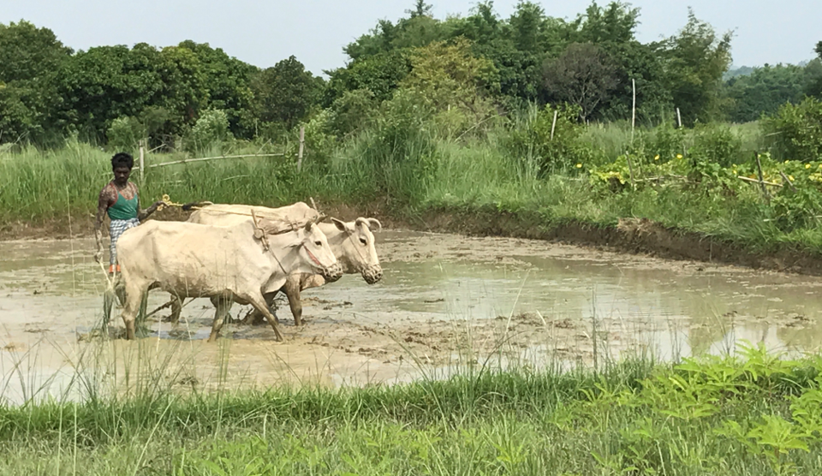

DEVELOPMENT FOR A BETTER FUTURE
MODULE 1
Climate Change
Year 9 and 10
Free for Educational Use in Australian Schools
Making a Global Difference: Development for a Better Future © 2024 by Crawford Fund is licensed under CC BY-NC 4.0

Slide 2
Module 1: Climate Change
Inquiry Question
  What is the impact of climate change on development, and food and nutrition security in the Asia Pacific region and what could we recommend to farmers in these countries?
Guiding Questions
  How is climate change impacting on development, and on food and nutrition security?
  What is food and nutrition security and why does it matter?
  What is being done in the Asia Pacific region to support food and nutrition security?
  Why is Australia supporting developing countries in food and nutrition security?

Slide 3
Students will:
Review
Review Asia Pacific agricultural practices tackling climate change and the impact it has on food and nutrition security.
Identify
Identify the desired future for agriculture in the Asia Pacific region.
Produce
Produce a project plan outlining how Australia could support farmers in the Asia Pacific Region.
Activate
Activate the project plan by presenting it to your class.
Share
Send your ideas or videos to the Crawford Fund which may showcase your work.
Share prior knowledge
What do you know about farming?
What do you know about climate change?
What is food and nutrition security?

Slide 4

What do you know?
In groups, share what you know about climate change and its impact on the environment and agriculture.
What is food and nutrition security?
What do you know about farming in Australia or the Asia Pacific region (things you have seen on TV; if you have travelled there; what family or friends have shared)?
Once you have recorded your knowledge, view the videos on slides 8 – 11.
Record your insights.
Share with the class.

Slide 5
Record your sharing – Climate Change
Initial Thoughts
Now I think – after viewing videos

Slide 6
Record your sharing –
Food and Nutrition Security
Initial Thoughts
Now I think – after viewing videos

Slide 7
Record your sharing –
Agriculture in the Asia Pacific
Initial Thoughts
Now I think – after viewing videos

Slide 8
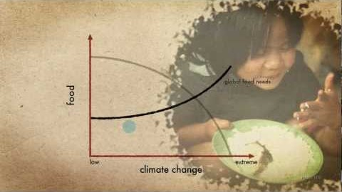
How is climate change affecting food and nutrition security?
What are the key climate change factors affecting agriculture?
How are these factors impacting on the environment, agricultural production, food and nutrition insecurity?
How do we sustainably feed the future population (estimated to be 9 billion by 2050)?
What action is required to meet these needs?
What action can Australia take?
https://www.youtube.com/watch?v=gjtIl5B1zXI&feature=emb_logo

Slide 9
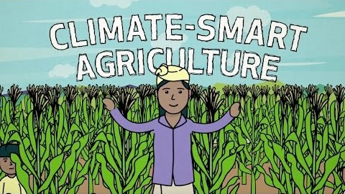
Climate-Smart Agriculture
How do we adapt and change to meet the climate change challenge? The best outcomes include:
More food
Healthier landscapes
Plants and soil capturing more carbon
What are the challenges?
https://www.youtube.com/watch?time_continue=1&v=q7JnJ0oBa94&feature=emb_logo

Slide 10
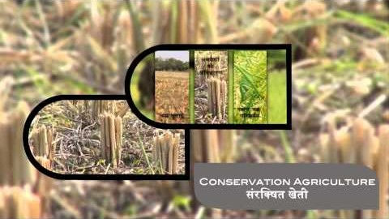
Agricultural practice in the Asia Pacific
What are the climate change challenges for the Asia Pacific region?
What are farmers witnessing in their climate and environment?
What are some of the changes in agricultural practice being implemented in climate-smart villages in South Asia?
https://www.youtube.com/watch?time_continue=312&v=-xI9VVGEeR0&feature=emb_logo

Slide 11
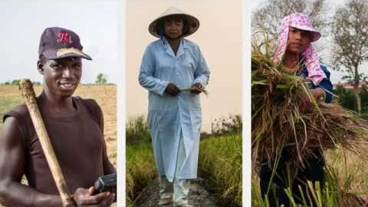
Agricultural practice in the Asia Pacific
And again….
What are the climate change challenges for the Asia Pacific region?
What are farmers witnessing in their climate and environment?
What are some of the changes in agricultural practice being implemented in climate-smart villages in South Asia?
https://www.youtube.com/watch?time_continue=183&v=OjhRfvdc7bA&feature=emb_logo

Slide 12
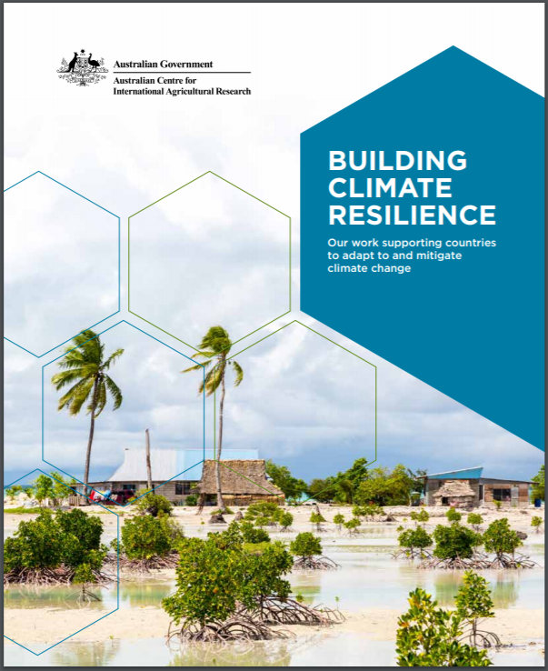
Building Climate Resilience
Use examples from Building Climate Resilience to review climate smart technologies and how they are supporting agriculture in the face of climate change.
Select one of the countries in this publication or use one of following scenarios.
Use the sample case study on Fiji to help you create a report that outlines how Australia could support farmers in the Asia Pacific Region to address climate change issues.
https://aciar.gov.au/publication/books-and-manuals/building-climate-resilience

Slide 13
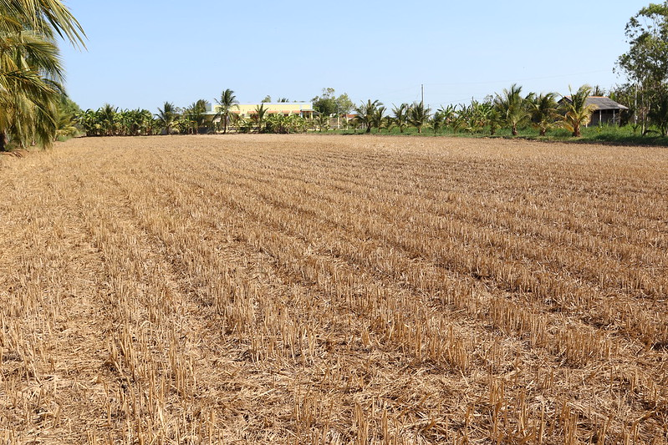
Scenario 1
In the Mekong Delta in Vietnam, smallholder farmers are facing challenges with drought and salinity for their rice crops.
What would you suggest as a way to help these farmers?
How can farmers conserve water and reduce the salt in the soil?
https://www.aciar.gov.au/media-search/blogs/lessons-rice-fields

Slide 14
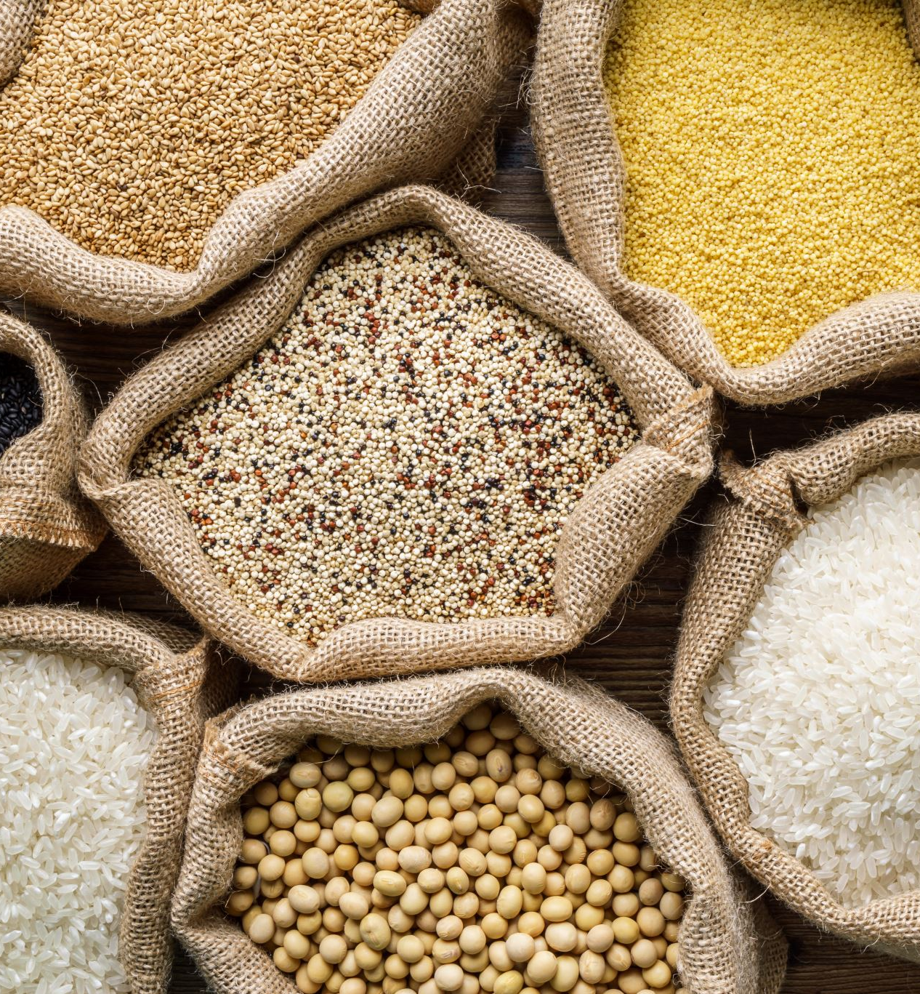
Scenario 2
Globally, about a third of all food is lost or wasted every year, accounting for a quarter of the calories that would have been available for human consumption. In a world where one in nine people goes hungry, food loss and waste are urgent issues.
What could be some ways that you could reduce food waste in your community?
What solutions could you suggest to farmers in developing countries?

Slide 15
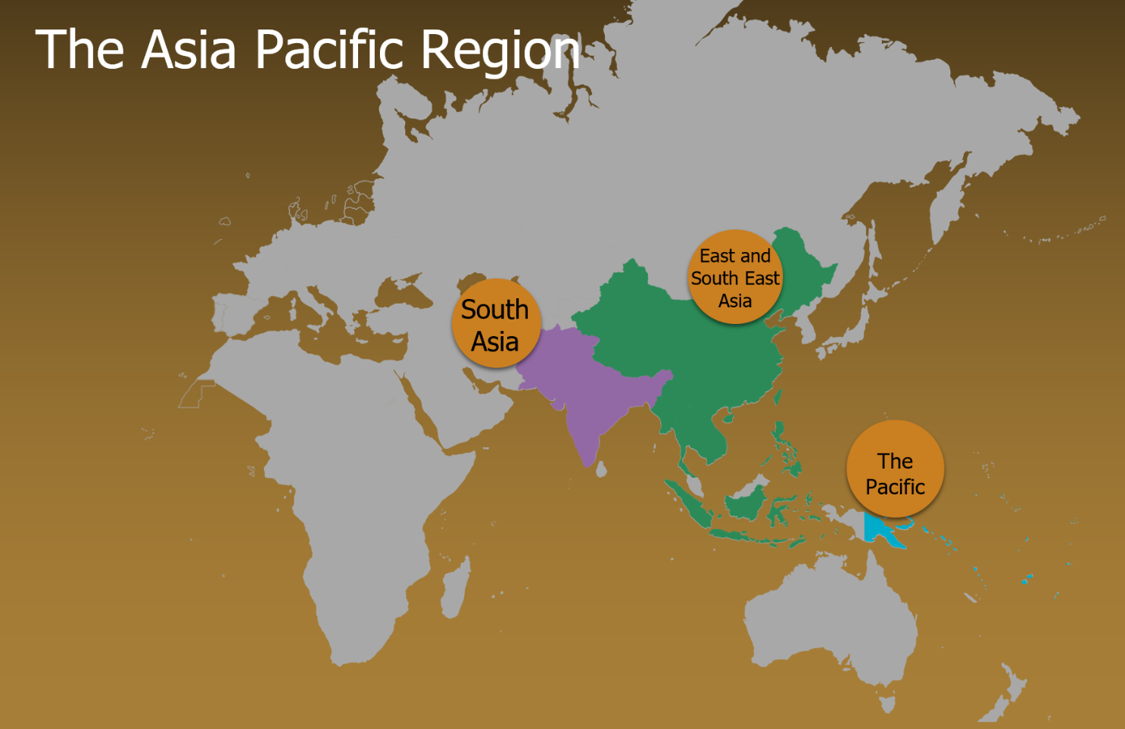
Research an Asia Pacific country and how climate-smart agricultural practices could better support farmers.
India
Vanuatu
Papua New Guinea
Kiribati and Tuvalu
Myanmar
Philippines
Bangladesh
India
Vietnam
Nepal
Indonesia

Slide 16
Report
Create a report to outline how Australia could support farmers in the Asia Pacific Region to address climate change challenges. See the following slides for a breakdown on each section.
Introduction
What is the country and where is it located (include a map)?
List the climate challenges faced by this country.
Body
What are the climate challenges faced by this country (use data and identify patterns, trends and relationships)?
Explain a maximum of three agricultural practices.
List of References
Include a list of references for your report.
What is the purpose of this report?
Recommendations
What is the distribution of biomes (include a map)?
What are the agricultural challenges caused from the climate challenges?
How will the agricultural practice support development for a better future?
Implementation
What is the timeline for implementation?
What is required for the agricultural practice to succeed? What resources, people, technology or products?
What support do you need from Australia to activate your recommendation? Why should Australia contribute to this?
Which agricultural practice is recommended to support development for a better future according to economic, environmental and social factors?

Slide 17

Research for the Introduction
What is the country and where is it located?
  Use BOLTSS conventions to create a map and refer to the map in your introduction.
  You could research one or use Google Maps or Mapmaker to create your own.
  See example on the next slide.
B
Border
O
Orientation
L
Legend
T
S
S
Title
Scale
Source

Slide 18
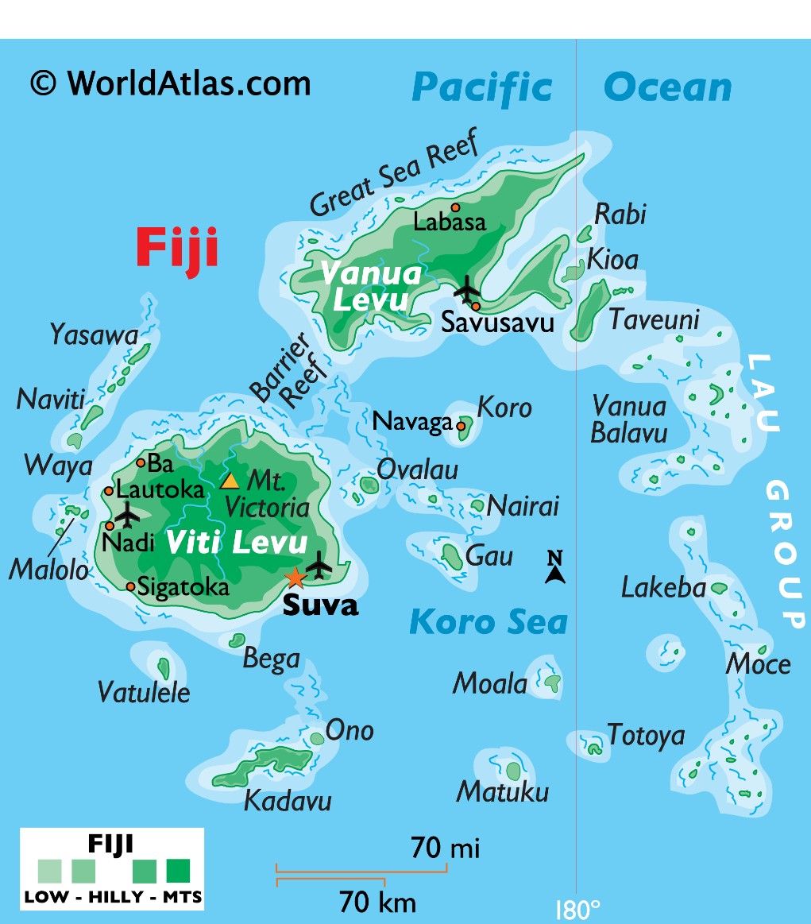
Fiji Case Study – Example Map with BOLTSS and explanation
Map of Fiji
Identify the BOLTSS conventions on the map.
Write one – two sentences to explain the location of your chosen country.
Fiji is a group of over three hundred islands encompassing an area of about 18,000 km2 located in the South Pacific Ocean (see Map 1). It is approximately 2,000 km north of New Zealand and 3,000 km east of Australia.

Slide 19
Research for the Introduction
Use a map to show the distribution of biomes in your country
  Use BOLTSS conventions to create a map and refer to the map in your introduction.
  You could research one or use Mapmaker or Ecoregions to create your own.
  See example on the next slide.
B
Border
O
Orientation
L
Legend
T
S
S
Title
Scale
Source

Slide 20
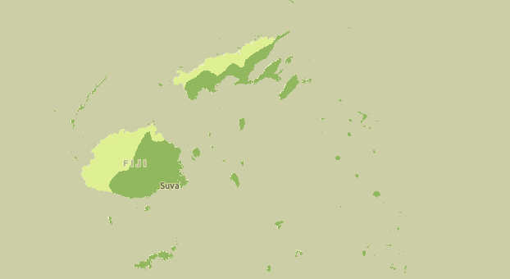

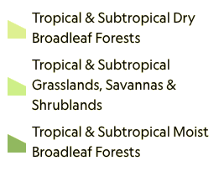

Fiji Case Study – Example Map of Biome Distribution
Map of Biome distribution in Fiji
Source: https://mapmaker.nationalgeographic.org/map/8ac78d1158ca4b4eb149d8959f0c8c34

Slide 21
Research for the Introduction
List any of the climate challenges faced by your country. For example:
  global temperature rise,
  drought,
  ocean acidification,
  shrinking ice sheets,
  flooding and erosion in coastal areas,
  declining water resources,
  rising sea levels, and
  increasing extreme weather events.

Slide 22
Fiji Case Study – Example Introduction
Fiji is a group of over three hundred islands encompassing an area of about 18,000 km2 located in the South Pacific Ocean (see Map 1). It is approximately 2,000 km north of New Zealand and 3,000 km east of Australia. The two main biomes covering Fiji are the tropical & Subtropical dry and moist broadleaf forests. Fiji's significant environmental challenges include rising sea levels, deforestation, and warmer temperatures. Fiji will need to implement more flexible farming systems that are tolerant to climate variations to ensure they can remain sustainable with food production. This report will use data to show the environmental challenges in Fiji and provide recommendations to support the Fijian farmers.

Slide 23

Research – Data
Use data to explain the climate challenges faced by this country.
Brainstorm as a class the type of data you could collect to support your research.

Slide 24
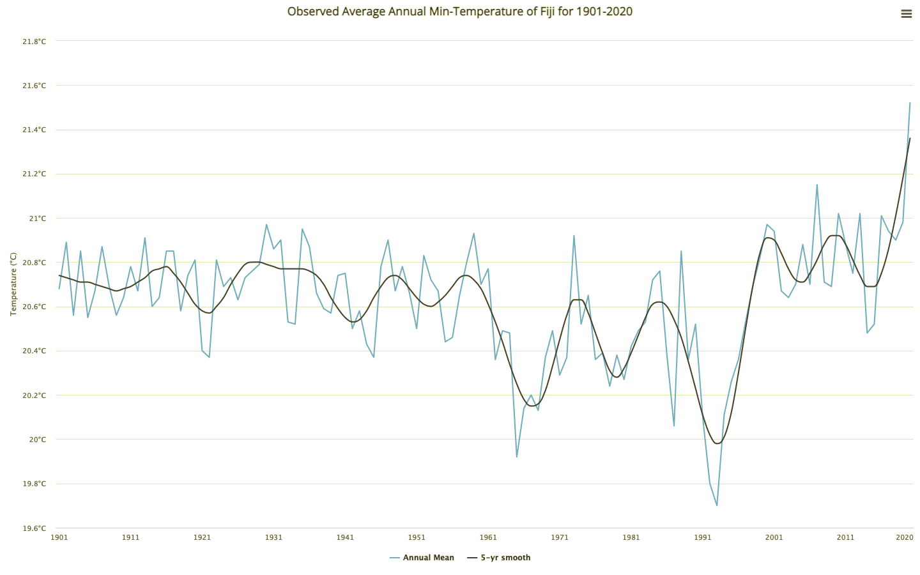
Fiji Case Study – Example Data
https://climateknowledgeportal.worldbank.org/country/fiji/climate-data-historical#:~:text=Temperatures%20in%20the%20vicinity%20of,0.1%C2%B0C%20per%20decade)

Slide 25
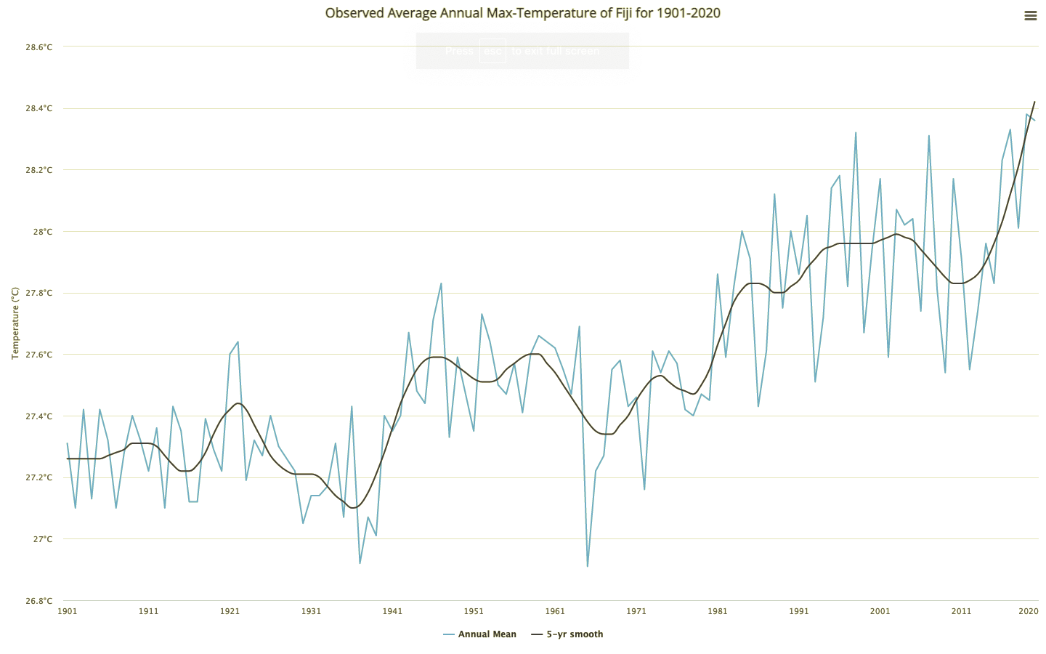
Fiji Case Study – Example Data
https://climateknowledgeportal.worldbank.org/country/fiji/climate-data-historical#:~:text=Temperatures%20in%20the%20vicinity%20of,0.1%C2%B0C%20per%20decade)

Slide 26
Fiji Case Study – Example of Identifying Patterns, Trends and Relationships from the data.
Fiji has experienced hotter temperatures, which is an effect of climate change and is shown in the minimum and maximum temperature graphs (see Figures 1 and 2). Warming has been strongest in daily maximum temperatures (around 0.2°C per decade) and similar in daily minimum temperatures (around 0.1°C per decade).
https://climateknowledgeportal.worldbank.org/country/fiji/climate-data-historical#:~:text=Temperatures%20in%20the%20vicinity%20of,0.1%C2%B0C%20per%20decade)

Slide 27
Research for the Introduction
Use the data to explain the agricultural challenges caused from the climate challenge.

Slide 28
Fiji Case Study – Example explanation
These hotter temperatures create challenges for agriculture production because they create an increase in soil temperature making the crops vulnerable.

Slide 29
Fiji Case Study – Example data analysis paragraph
Fiji has experienced hotter temperatures, which is an effect of climate change and is shown in the minimum and maximum temperature graphs (see Figures 1 and 2). Warming has been strongest in daily maximum temperatures (around 0.2°C per decade) and similar in daily minimum temperatures (around 0.1°C per decade). These hotter temperatures create challenges for agriculture production because they create an increase in soil temperature making the crops vulnerable.

Slide 30
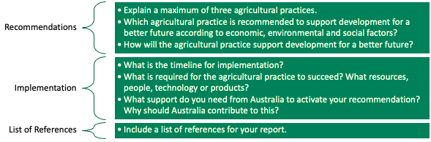
Recommendations
As a class, share the different agricultural practices from the report.
Individually, select a maximum of three agricultural practices that could benefit your country.

Slide 31
Recommendations
For each agricultural practice, use a separate table below to analyse it according to economic, environmental and social factors. Include the table in your report.
From the information in the tables, select the most appropriate recommendation for your country and explain how it will support the development of a better future.
Factors | Positive Impacts | Negative Impacts
Economic
Environmental
Social

Slide 32
Implementation – Your time to be creative!
For the selected recommendation, include information about the following:
What is the timeline for implementation?
What is required for the agricultural practice to succeed? What resources, people, technology or products?
What support do you need from Australia to activate your plan? Why should Australia contribute to this?

Slide 33
List of References
Include a list of references of all the sources used within your report.

Slide 34

The farmers need your help!
Present your learning! You may choose to do this individually or in groups:
  A detailed illustration/diagram
  Write a blog or an essay
  A slide deck (PowerPoint)
  A video
  A dramatisation/skit
Send your ideas or videos to the Crawford Fund – schools@crawfordfund.org. You may just help a farmer in need or an Australian researcher. The Crawford Fund may choose to showcase your work!

Slide 35
Module 1: Climate Change - Report Rubric (Geography)
 | A | B | C | D | E
Knowledge and understanding | comprehensive explanation of a country in the Asia Pacific Region, including the location and distribution of biomes | detailed explanation of a country in the Asia Pacific Region, including the location and distribution of biomes | explanation of a country in the Asia Pacific Region, including the location and distribution of biomes | description of a country in the Asia Pacific Region, including the location and biomes | statements about a country in the Asia Pacific Region
 | comprehensive explanation of how climate challenges result in agricultural challenges | detailed explanation of how climate challenges result in agricultural challenges | explanation of how climate challenges result in agricultural challenges | description of how climate challenges result in agricultural challenges | statements about climate challenges
 | discerning analysis of agricultural practices to a climate challenge using environmental, social and economic criteria | informed analysis of agricultural practices to a climate challenge using environmental, social and economic criteria | analysis of agricultural practices to a climate challenge using environmental, social and economic criteria | explanation of agricultural practices to a climate challenge using aspects of environmental, social and economic criteria | statements about agricultural practices to a climate challenge
Acquiring geographical information | discerning selection and collection of relevant and reliable geographical information and data | effective selection and collection of relevant and reliable geographical information and data | selection and collection of relevant and reliable geographical information and data | selection and collection of aspects of relevant geographical information and data | selection and collection of limited geographical information and data
Processing geographical information | recording and accurate and detailed representation of data in a range of appropriate digital forms, including maps that comply with cartographic conventions (BOLTSS) | recording and detailed representation of data in a range of appropriate digital forms, including maps that comply with cartographic conventions (BOLTSS) | recording and representation of data in a range of appropriate digital forms, including maps that comply with cartographic conventions (BOLTSS) | recording and partial representation of data in digital forms, including maps that comply with aspects of cartographic conventions (BOLTSS) | recording and fragmented representation of data
 | discerning interpretation and analysis of maps, data and other information to: propose comprehensive explanations for patterns, trends, relationships and anomalies predict outcomes | effective interpretation and analysis of maps, data and other information to: propose informed explanations for patterns, trends, relationships and anomalies predict outcomes | interpretation and analysis of maps, data and other information to: propose explanations for patterns, trends, relationships and anomalies predict outcomes | Interpretation of maps, data and other information to: propose partial explanations for patterns, trends, relationships and anomalies predict outcomes | statements about maps, data and other information to propose fragmented explanations and predictions
Communicating geographical information | purposeful presentation of findings, arguments and explanations using: relevant geographical terminology digital representations in a range of appropriate communication forms | effective presentation of findings, arguments and explanations using: relevant geographical terminology digital representations in a range of appropriate communication forms | presentation of findings, arguments and explanations using: relevant geographical terminology digital representations in a range of appropriate communication forms | partial presentation of findings, arguments and explanations using: geographical terminology aspects of digital representations in appropriate communication forms | fragmented presentation of findings using: everyday language fragmented digital representations
 | justified proposal of agricultural practice, taking account of environmental, economic and social factors justified prediction of the outcomes and consequences of their agricultural practice | informed proposal of agricultural practice, taking account of environmental, economic and social factors plausible prediction of the outcomes and consequences of their agricultural practice | proposal of agricultural practice, taking account of environmental, economic and social factors prediction of the outcomes and consequences of their agricultural practice | identification of agricultural practice, taking account of aspects of environmental, economic and social factors prediction of aspects of outcomes and consequences of their agricultural practice | statement of action related to an agricultural practice statement about the outcomes

Slide 36
Resources
Big Picture:
Building Climate Resilience
https://aciar.gov.au/publication/books-and-manuals/building-climate-resilience
State of Food Security and Nutrition in the World 2020 http://www.fao.org/3/ca9692en/online/ca9692en.html#
Actions to Transform Food Systems Under Climate Change https://cgspace.cgiar.org/bitstream/handle/10568/108489/Actions%20to%20Transform%20Food%20Systems%20Under%20Climate%20Change.pdf
Reshaping Agriculture for Better Nutrition https://www.crawfordfund.org/wp-content/uploads/2019/01/2018-Crawford-Fund-Conference-Proceedings.pdf
Eat Lancet Report on Food Planet Health
https://eatforum.org/eat-lancet-commission/
Addressing the Ag, Energy, Water, Climate Change Nexus
https://www.crawfordfund.org/wp-content/uploads/2019/04/Crawford-Fund-2019-conference-proceedings-132ppcovers.pdf
Climate Smart Ag 101
https://csaguide.cgiar.org/#:~:text=CSA%20Guide%20provides%20a%20short,of%20specific%20topics%20of%20interest
Global Research Alliance on Agricultural Greenhouse Gases
https://globalresearchalliance.org/

Slide 37
Projects:
Climate Smart Villages
https://ccafs.cgiar.org/climate-smart-villages#.XzCeASgzZPY
Smart food, The Initiative: Good for the Planet https://www.smartfood.org/the-initiative/good-for-the-planet/
Picture and Satellite Based Insurance
https://aciar.gov.au/project/gp-2019-177
Reducing climate risk in the Pacific
https://aciar.gov.au/project/hort-2012-011
Mitigation Options Fiji and Vietnam
https://aciar.gov.au/project/lwr-2017-029
Managing Climate Risk – Philippines
https://aciar.gov.au/project/asem-2014-051
Food Loss and Waste
https://www.ifpri.org/topic/food-loss-and-waste

Slide 38
Key words
Adaptation – the process of changing to become more suited to the environment.
Ameliorate – make something better.
Capacity - the amount that something can produce.
Consumption - the action of using up a resource.
Emission reduction – reducing greenhouse gases.
Food security – as defined by the United Nations’ Committee on World Food Security, means that all people, at all times, have physical, social, and economic access to sufficient, safe, and nutritious food that meets their food preferences and dietary needs for an active and healthy life.
Integration - the action or process of combining two or more things in an effective way.
Reliant - needing a particular thing or person in order to continue, to work correctly, or to succeed.
Mitigation - the action of reducing the severity, seriousness, or painfulness of something.
Simulation - a model of a set of problems or events that can be used to teach someone how to do something, or the process of making such a model.
Sustainable - causing little or no damage to the environment and therefore able to continue for a long time.

Slide 39
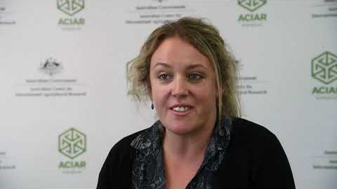
What is the Australian Centre for International Agricultural Research (ACIAR) and what does it do?
ACIAR is the Australian Government’s specialist agricultural research-for-development agency, within the Australian aid program. Its purpose is to contribute to reducing poverty and improving the livelihoods of many in the Indo-Pacific region through collaborative international research which also serves to improve Australian scientific capabilities and the productivity and sustainability of agricultural systems in Australia.
Hear from ACIAR staff on what makes international agricultural research a good career choice.
https://www.youtube.com/watch?v=MuiJzHzYBMo

Slide 40
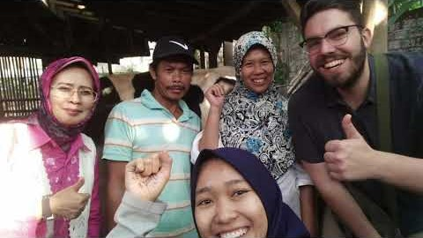
What is the Crawford Fund and what does it do?
The Crawford Fund highlights benefits to Australia and developing countries of research for agriculture and development; supports Australians in training developing country scientists and farmers, and supports young Australians in their careers, studies and volunteering for food and nutrition security.
Hear from young Australian researchers working in the Asia Pacific Region.
https://www.youtube.com/watch?v=KxVhJ8fDjj4&feature=emb_logo

Slide 41

Learn more about the Sustainable Development Goals
https://www.un.org/sustainabledevelopment/student-resources/

Slide 42
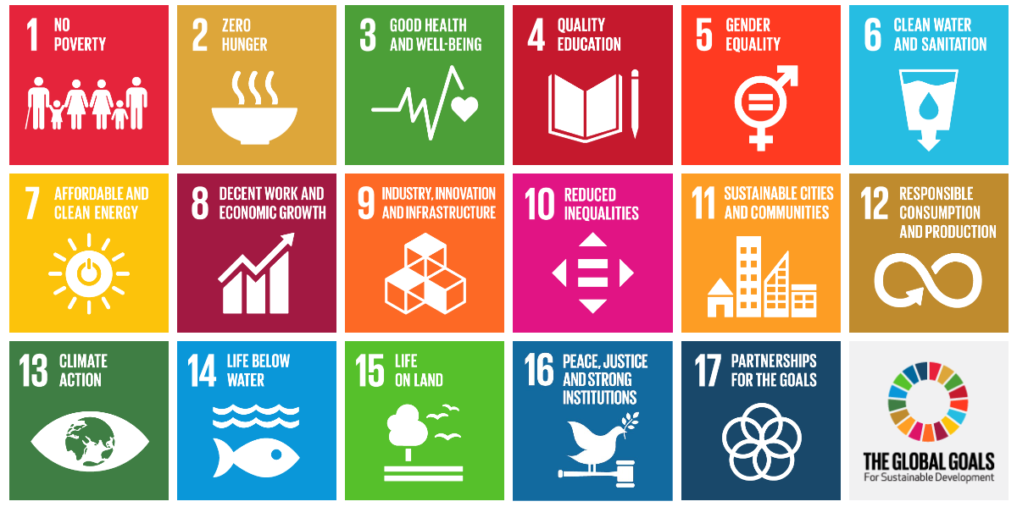
Sustainable Development Goals
https://worldslargestlesson.globalgoals.org/

Slide 43

Credits
These teaching materials are part of the Crawford Fund’s NextGen program, to encourage the next generation into studies, careers and volunteering for global food and nutrition security. Further information is at www.crawfordfund.org and additional teaching materials are available by contacting us at schools@crawfordfund.org
The Crawford Fund and our NextGen project is supported by the Australian Centre for International Agricultural Research. More information on ACIAR is available at www.aciar.gov.au
This resource was developed by Heather MacDonald, Director of Education Partnerships (Schools) Pty Ltd. www.educationpartnerships.com.au

