Slide 1
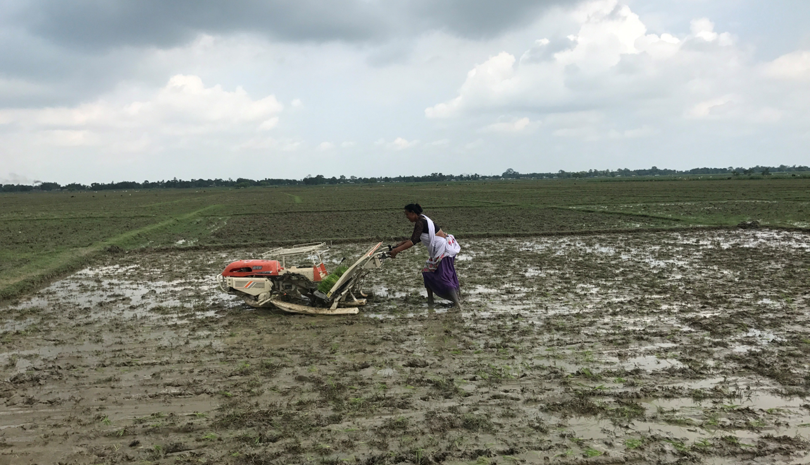


DEVELOPMENT FOR A BETTER FUTURE
MODULE 5
Gender Dimensions in Agriculture
Year 9 and 10
Free for Educational Use in Australian Schools
Making a Global Difference: Development for a Better Future © 2024 by Crawford Fund is licensed under CC BY-NC 4.0

Slide 2
Module 5: Gender Dimensions in Agriculture
Inquiry Question
  What are the challenges to gender equity in agriculture and how do they impact the farmer, the community and the country?
Guiding Questions
  What are the barriers that women and girls face in agriculture?
  How can technological and institutional innovations and interventions improve women’s empowerment and agricultural outcomes for women and families?
  How can we share our learning to our class and others through a
  3-minute video?

Slide 3
Students will:
Review
Review video interviews and case studies in developing countries and Australia on gender challenges and opportunities in agriculture.
Review some of the strategies to support women and girls in agriculture.
Identify
Identify a business or economic challenge from the case studies on women in agriculture.
Review some of the projects being implemented to address this challenge.
Produce
Produce a 3-minute video to share your learning.
Generate success criteria to assess options presented by the class groups.
Share
Load your video onto an online platform to generate awareness of the challenges and opportunities to gender in agriculture.
Share your videos with the Crawford Fund who would like to showcase your work to their networks.
Share prior knowledge
Share your current ideas, knowledge and understanding of gender in agriculture.

Slide 4
Definitions
Gender – refers to the socially constructed roles and responsibilities of women, men and non-binary people. There are more than two genders often widely accepted in some countries, for example fakaleitīs in The Pacific Islands and the Bugis people of Indonesia.
Sex – the two main categories (male and female) into which humans and most other living things are divided on the basis of their reproductive functions.
Developing countries – countries with a less developed industrial base and lower per capita income than other countries. They generally rely heavily on agriculture as their primary industry.
Equity - the quality of being fair and impartial.
Equality - the state of being equal, especially in status, rights, or opportunities.
Gender equality - when people of all genders have equal rights, responsibilities and opportunities.
Empowerment - a process where a person gains the ability to set personally meaningful goals (i.e. to live the life one has reason to value), make choices with significant consequences for one’s life, and turn choices into desired action and outcomes.

Slide 5

What do you know?
In groups, discuss your thoughts on how gender impacts agriculture in developing countries and Australia. What do you think is the greatest challenge to gender disparity in agriculture?
Consider:
  Land ownership
  Financial support
  Education
  Gender stereotypes
  Representation in decision making
Use slides 7 – 9 to identify the opportunities and challenges.
In pairs record your learnings.
What are the similarities and differences between Australia and developing countries regarding gender challenges?
Review some of the international projects being implemented to support women in agriculture.

Slide 6
Record your sharing –
Gender challenges and barriers in agriculture
Initial Thoughts

Slide 7
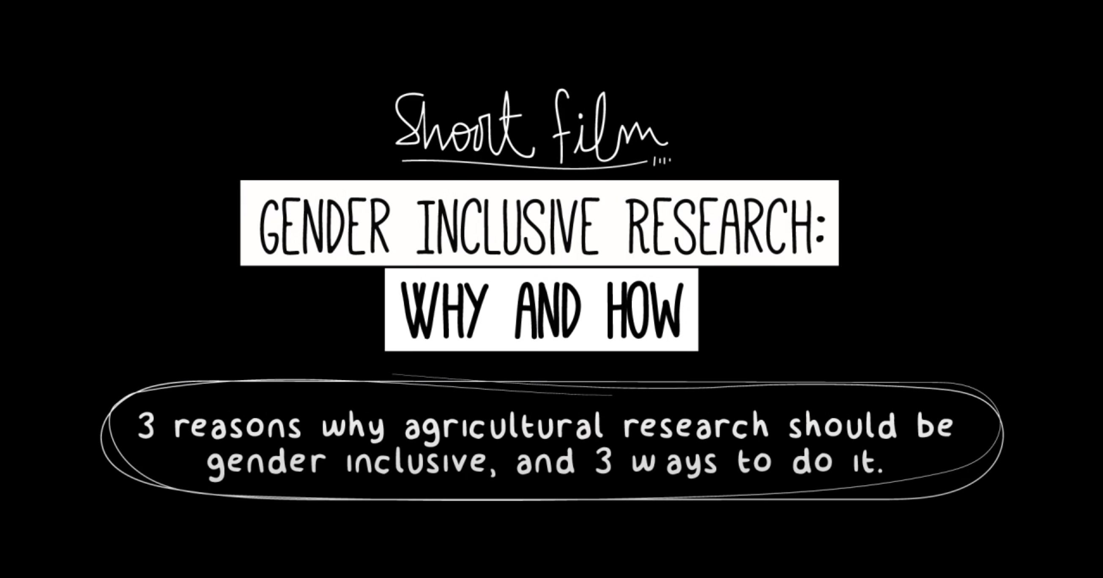
How is climate change impacting on communities in developing countries?
How does climate change disproportionately affect women and girls in developing countries?
What are the priorities for women in these countries?
What are some suggestions for meeting this challenge?
What role can we play in supporting women in agriculture in developing countries?
https://youtu.be/ony2GHjYEro

Slide 8
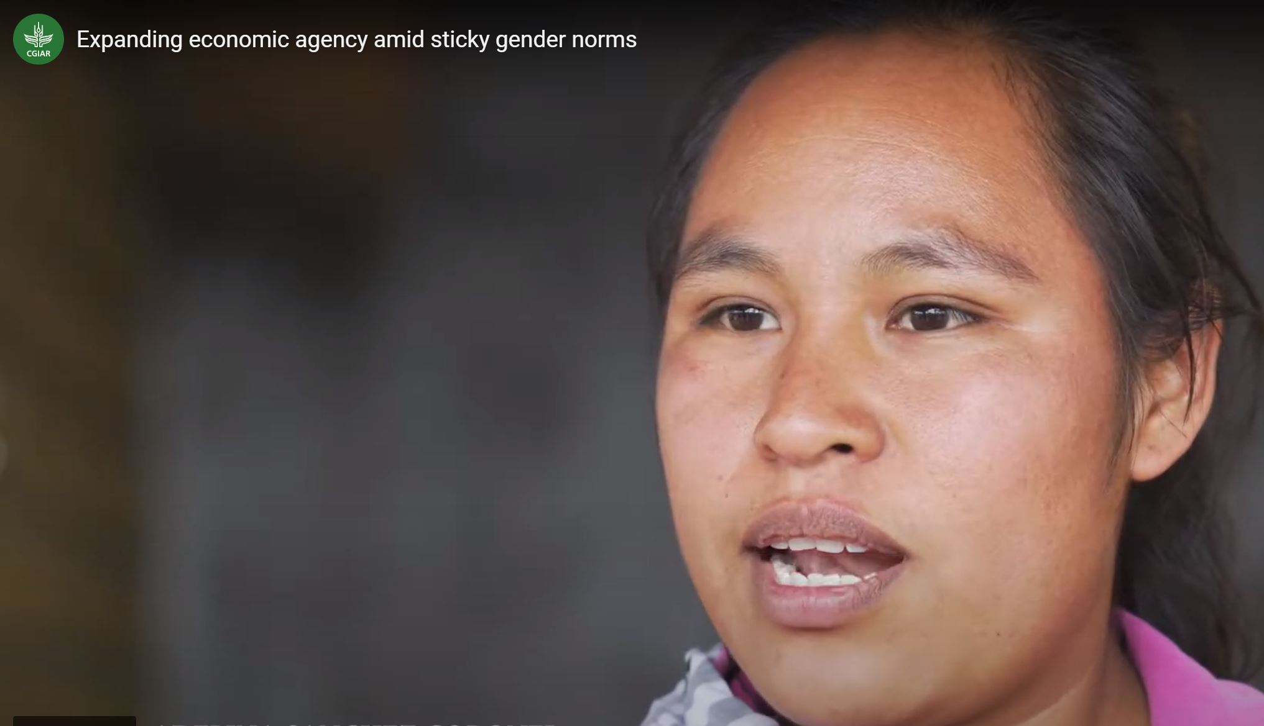
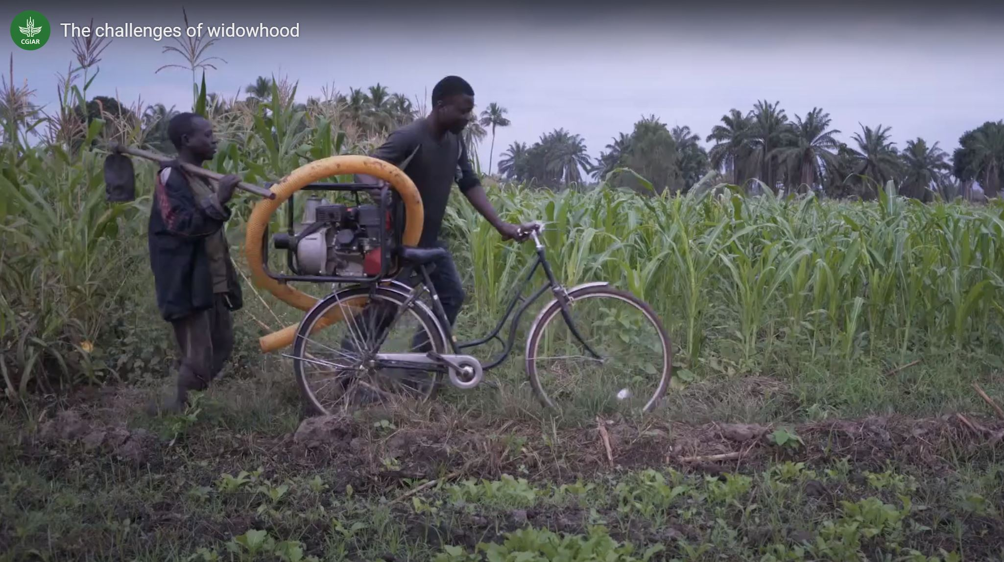
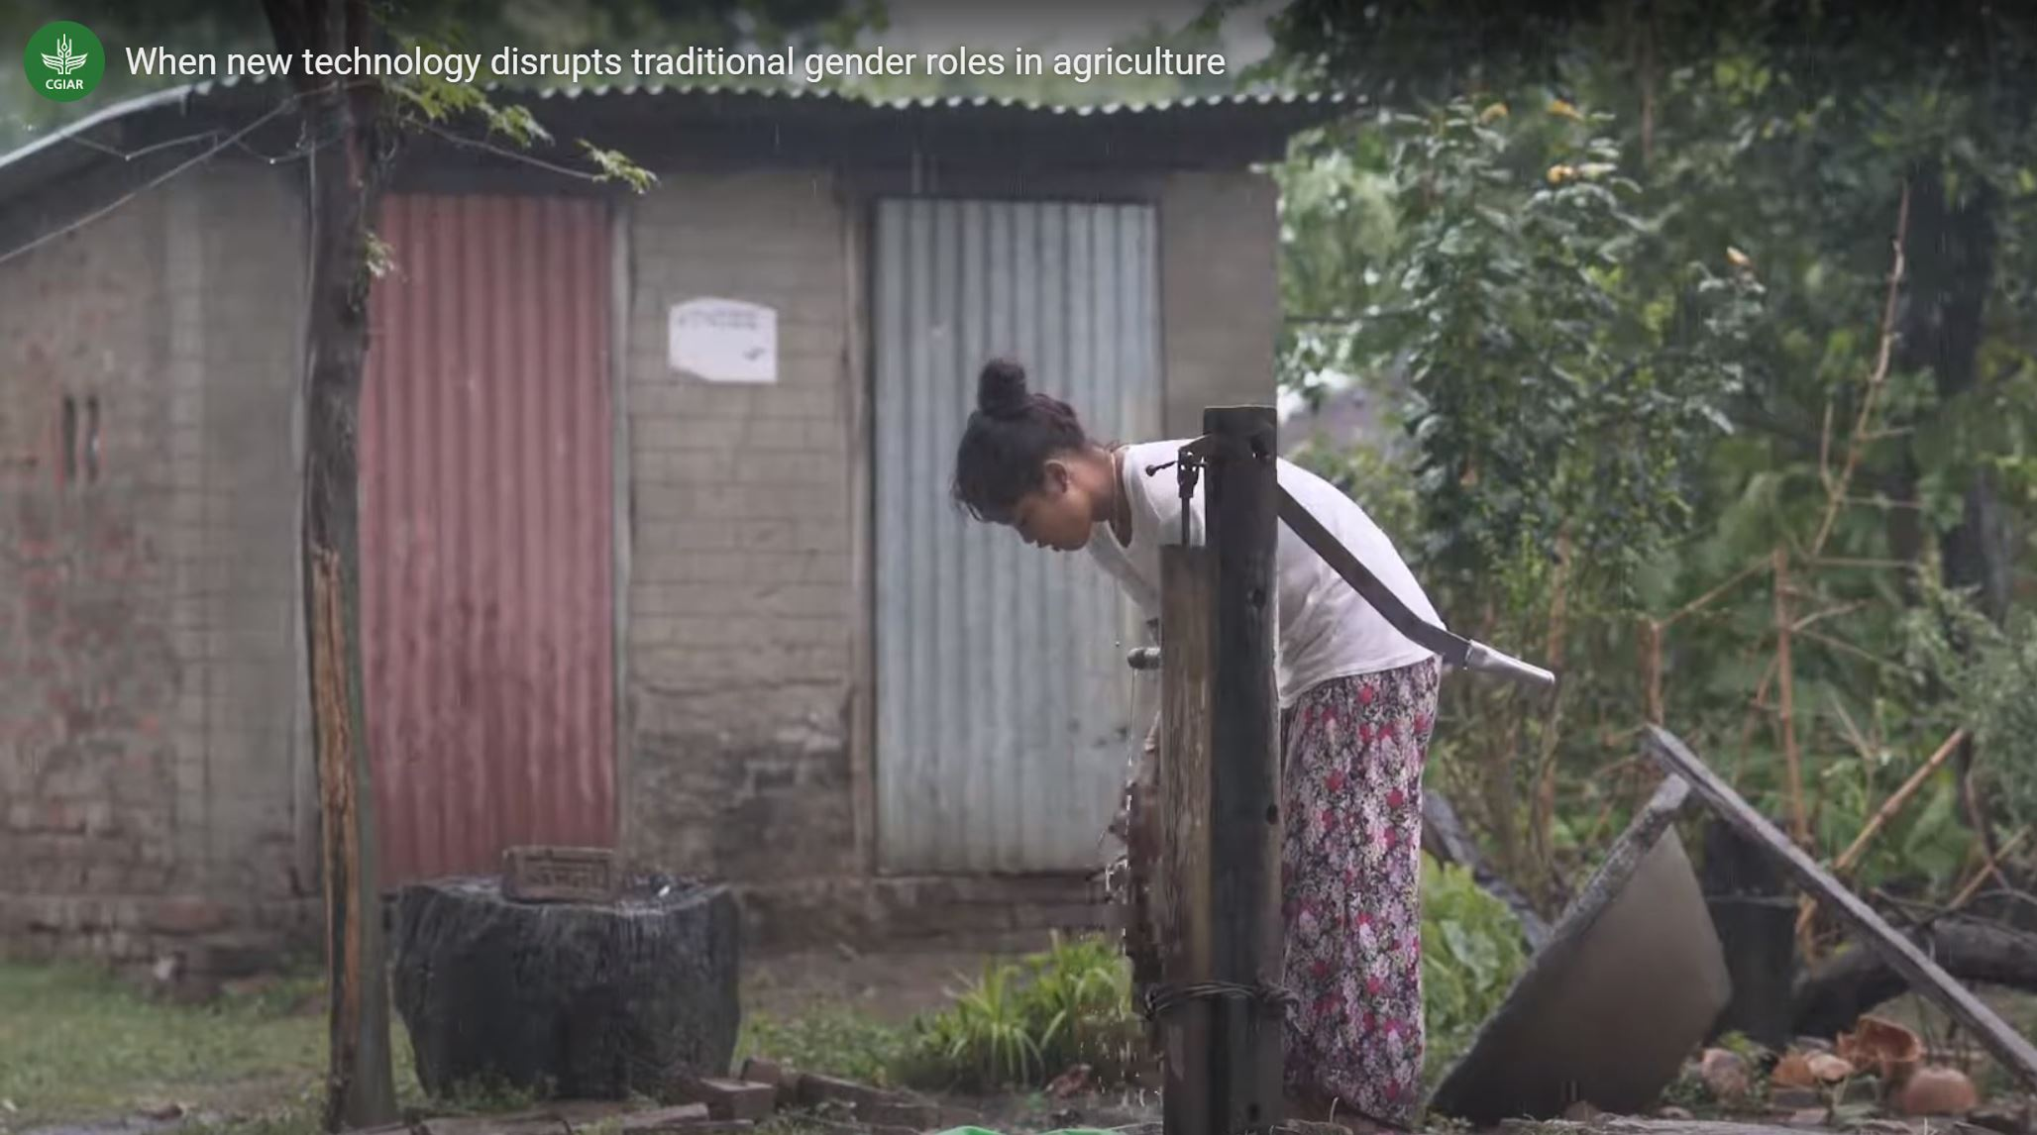
Gender Dimensions in Developing Countries
What are the opportunities and challenges for women and girls in agriculture?
Expanding economic agency amid sticky gender norms.
The Challenges of widowhood.
When new technology disrupts traditional gender roles in agriculture
Mexico
A young woman entrepreneur takes advantage of shifting societal norms that open space for women to work for pay, by pursuing a tortilla business.
Tanzania
In Tanzania, widows struggle after their husbands’ deaths to take over farm duties and fulfill their economic provider roles in order to feed themselves and their families.
Nepal
And in Nepal, women farmers face uncertainty due to an innovation that replaces manual farm tasks traditionally done by women.
Source: https://gennovate.org/multimedia/

Slide 9
Women in Agriculture in Developing Countries
– Opportunities and Challenges
In pairs, record your learning.
What are some of the surprising statistics, data, or stories you have seen in the video/s or in the articles?
Share with your class.
Opportunities
Challenges

Slide 10
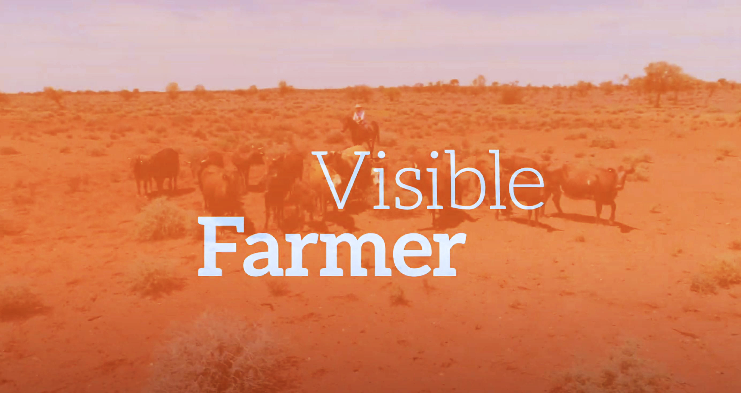
Gender dimensions in Australia
What are the opportunities and challenges for women and girls in agriculture?
Women in Agriculture – a snapshot https://www.anz.com.au/content/dam/anzcomau/documents/pdf/infocus-oct-2020-women-in-agri.pdf
How women are transforming agriculture in Australia? https://womensagenda.com.au/latest/how-women-are-transforming-agriculture-in-australia/
Empowering Women in Agriculture: Australia and Beyond https://apo.org.au/node/52512
Yes We’re Female and We’re Farmers
https://farmers.org.au/blog/yes-were-female-and-were-farmers/
Women are Farmers Too
https://www.dscribe.net.au/2021/03/09/women-are-farmers-too-changing-the-gender-divide-in-agriculture/
Who is a farmer anyway?
https://blog.agridigital.io/blog/who-is-a-farmer-anyway
Credit: Visible Farmer
https://youtu.be/Ola94LxrAH8

Slide 11
Australian Women in Agriculture –
Opportunities and Challenges
In pairs, record your learning.
What are some of the surprising statistics, data, or stories you have seen in the video/s or in the articles?
Share with your class.
Opportunities
Challenges

Slide 12
Women in Agriculture
What are the similarities and differences between Australia and developing countries in gender dimensions?
Similarities
Differences

Slide 13
Projects supporting Women in Agriculture
Review up to three of the following articles on how organisations such as ACIAR are supporting women in agriculture around the world. Write notes on the challenges and opportunities and how they are being addressed.
Select one of these to investigate further.
Gender and Fisheries
Gender and Livestock
Gender and Water
Gender and Wheat/Maize
Gender and Rice
CIAT Gender Analysis
Gender and Potatoes
Gender and Semi-Arid tropics
Gender and Dry areas
Additional projects are listed on slide 16.

Slide 14

Video
Select one of the case studies and produce a
3-minute video to share your learning.
Develop success criteria to access the options presented by student groups.
Share your video with your class and access them against agreed success criteria.
Send the top 3 – 5 to the Crawford Fund.

Slide 15
Module 5: GENDER DIMENTIONS IN Agriculture – video Rubric
 | A | B | C | D | E
Knowledge and understanding | comprehensive explanation of a project supporting women in agriculture | detailed explanation of a project supporting women in agriculture | explanation of a project supporting women in agriculture | description of a project supporting women in agriculture | statements about a project supporting women in agriculture
 | discerning analysis of a project supporting women in agriculture using environmental, social and economic criteria | informed analysis of a project supporting women in agriculture using environmental, social and economic criteria | analysis of a project supporting women in agriculture using environmental, social and economic criteria | explanation of a project supporting women in agriculture using aspects of environmental, social and economic criteria | statements about project supporting women in agriculture
Acquiring geographical information | discerning selection and collection of relevant and reliable information and data | effective selection and collection of relevant and reliable information and data | selection and collection of relevant and reliable information and data | selection and collection of aspects of relevant information and data | selection and collection of limited information and data
Processing geographical information | recording and accurate and detailed representation of data in a range of appropriate digital and non-digital forms | recording and detailed representation of data in a range of appropriate digital and non-digital forms | recording and representation of data in a range of appropriate digital and non-digital forms | recording and partial representation of data in digital and non-digital forms | recording and fragmented representation of data
Communicating geographical information | purposeful presentation of findings, arguments and explanations using relevant terminology | effective presentation of findings, arguments and explanations using relevant terminology | presentation of findings, arguments and explanations using relevant terminology | partial presentation of findings, arguments and explanations using terminology | fragmented presentation of findings using everyday language

Slide 16
Resources
Further reading
Gender Transformative approach for food security, improved nutrition and sustainable agriculture.
Gender Equality in Food Systems
Gender and Rural Transformation
Generic catchphrase or global commitment: What is women’s empowerment?
Gender-Equitable pathways to achieving sustainable agricultural intensification
Scaling out Gender Transformation for Climate Change
Transformative engagements – a new way to discuss gender relations in agriculture.
Opinion: 4 Revolutionary trips to stop aquaculture and fisheries ignoring, resisting or eroding gender equity.
Kreative Koalas - SDG5 Gender Equality
Gender Relations
Rural Women’s Role in Pacific Fisheries
Towards Gender Equality in Agriculture
Gender Equality Research

Slide 17
Projects:
Cool Women of Malaita (Solomon Islands)
Gender Equity and Women's Empowerment
Gender-related Projects
Improving opportunities for economic development for women smallholders in rural PNG
Improving agricultural development opportunities for female smallholders in rural Solomon Islands
Gender equitable agricultural extension through institutions and youth engagement in Papua New Guinea
Analysing Gender Transformative Approaches to Agricultural Development with Ethnic Minority Communities in Vietnam
Identifying opportunities and constraints for rural women’s engagement in small-scale agricultural enterprises in Papua New Guinea

Slide 18
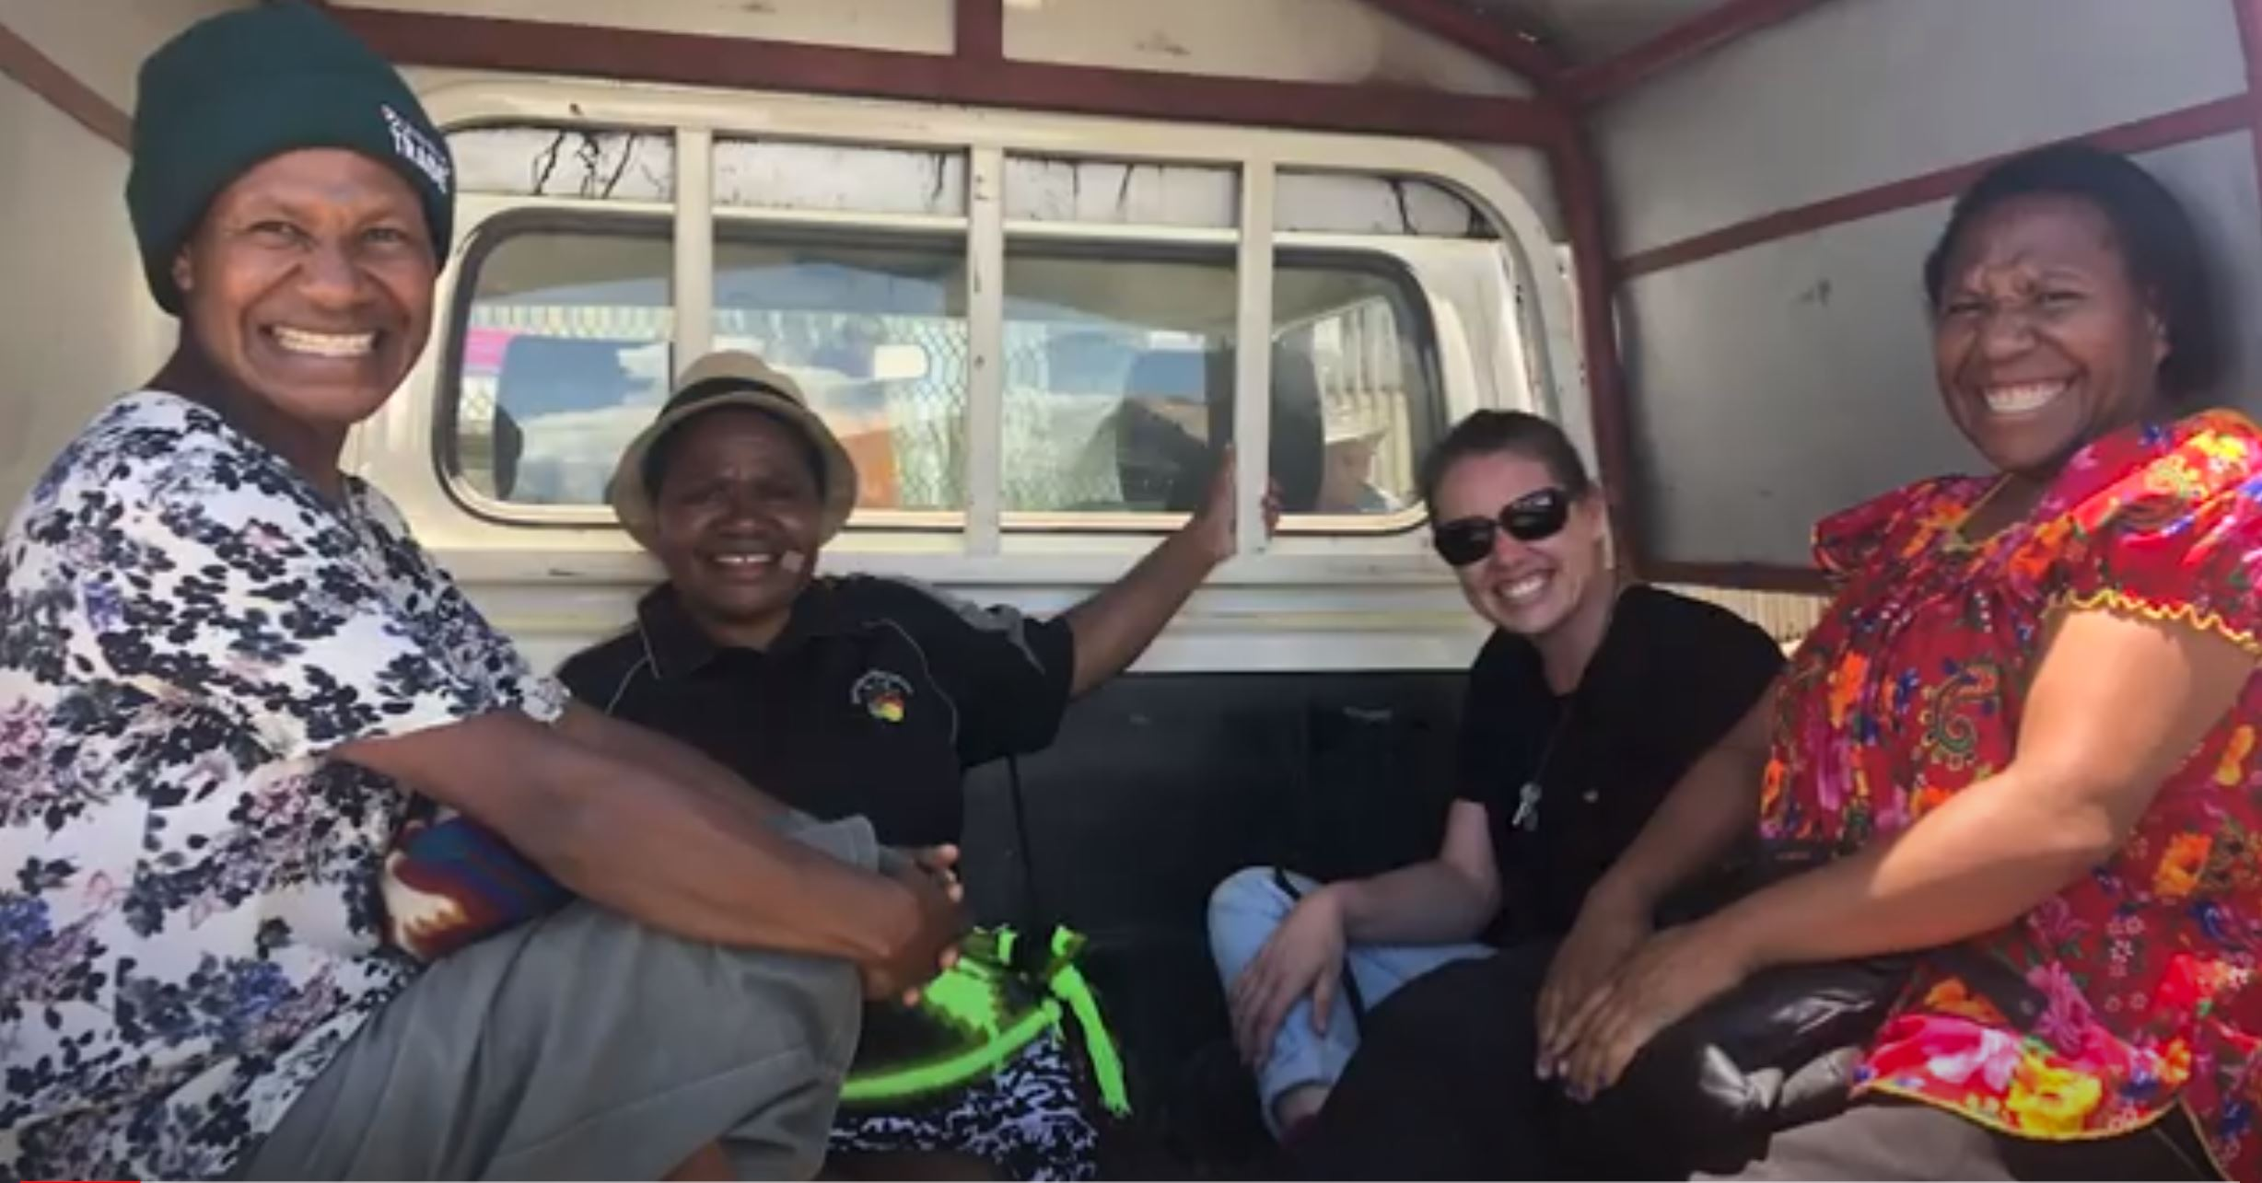
Career Pathways to Agriculture for Development
There are many and varied pathways to agriculture for development, other than by studying agriculture!
https://www.youtube.com/watch?v=60-HXBsad_Y&t=58s

Slide 19
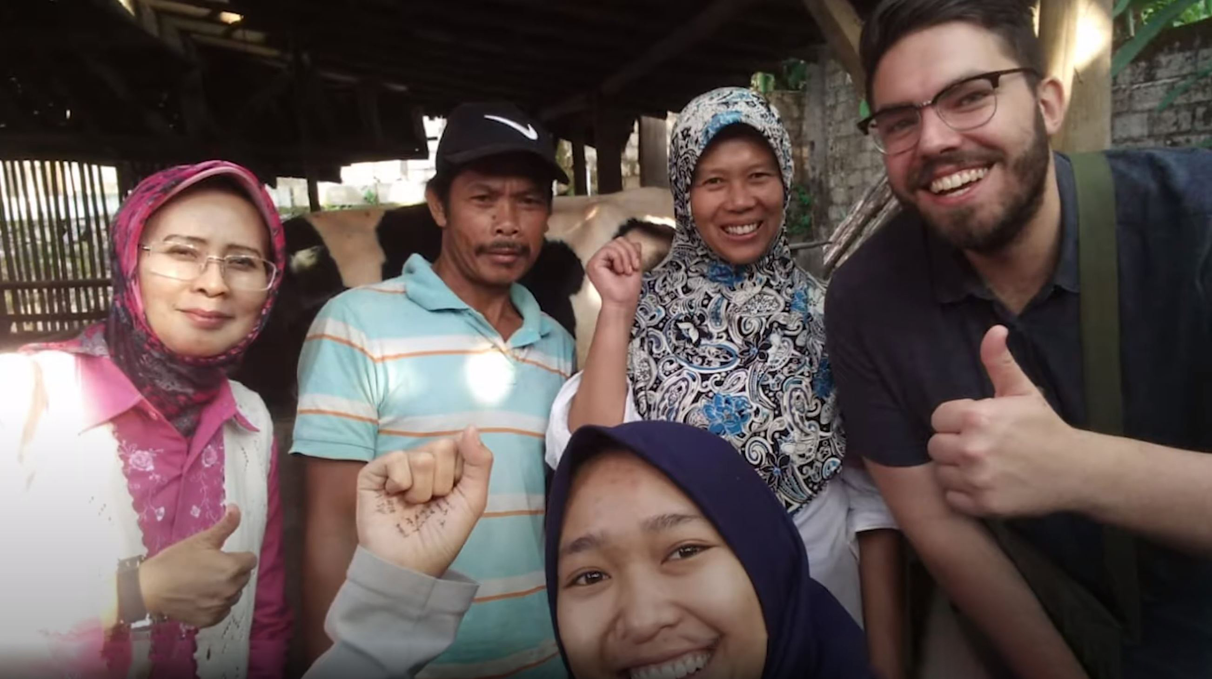
What is the Crawford Fund and what does it do?
The Crawford Fund provides university students with awards to gain experience in developing countries, conference scholarships to learn and be mentored by senior Australian researchers, and opportunities to volunteer in our overseas projects. It also supports Australians in training developing country scientists and farmers and has trained close to 13,500 people in 55 countries.
More info at www.crawfordfund.org and follow @crawfordfund on Twitter, Facebook and Instagram.
Hear from young Australian researchers working in the Asia Pacific Region.
https://www.youtube.com/watch?v=KxVhJ8fDjj4

Slide 20
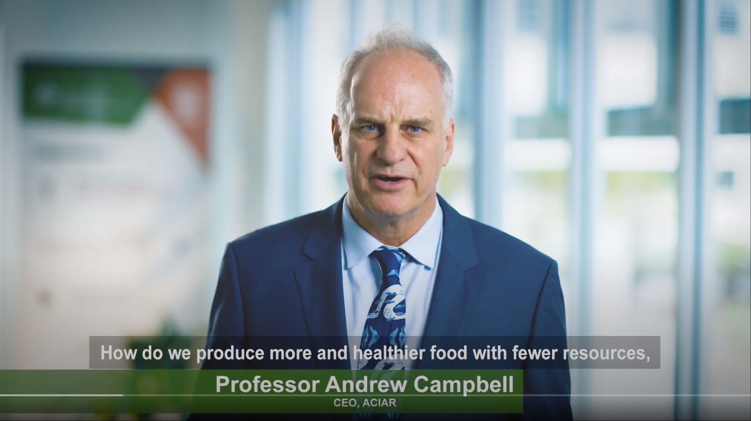
What is the Australian Centre for International Agricultural Research (ACIAR) and what does it do?
ACIAR is the Australian Government’s specialist agricultural research-for-development agency, within the Australian aid program. Its purpose is to contribute to reducing poverty and improving the livelihoods of many in the Indo-Pacific region through collaborative international research which also serves to improve Australian scientific capabilities and the productivity and sustainability of agricultural systems in Australia. More info at www.aciar.gov.au and follow on Twitter, Facebook and Instagram @ACIARAustralia
Learn more about ACIAR in this short video.
Credit: ACIAR
https://youtu.be/Mc5-gSTlnY0

Slide 21

Learn more about the Sustainable Development Goals
https://www.un.org/sustainabledevelopment/student-resources/

Slide 22
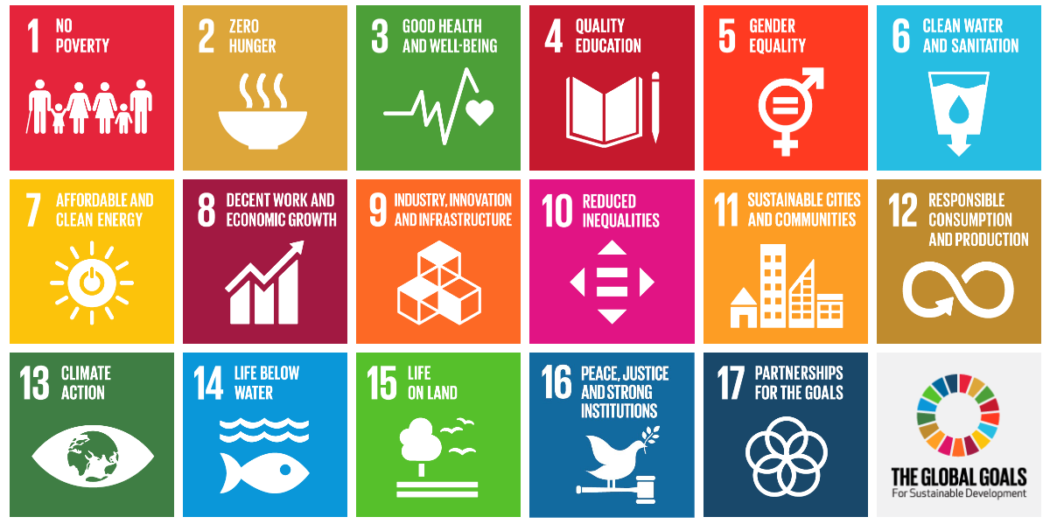
Sustainable Development Goals
https://worldslargestlesson.globalgoals.org/

Slide 23

Credits
These teaching materials are part of the Crawford Fund’s NextGen program, to encourage the next generation into studies, careers and volunteering for global food and nutrition security. Further information is at www.crawfordfund.org and additional free teaching materials are available by contacting us at schools@crawfordfund.org
The Crawford Fund and our NextGen project is supported by the Australian Centre for International Agricultural Research. More information on ACIAR is available at www.aciar.gov.au
Our thanks go to the CGIAR Gender Platform, Visible Farmer, Dr Robyn Alders and Dr Jayne Curnow for their assistance.
This resource was developed by Heather MacDonald, Director of Education Partnerships (Schools) Pty Ltd. www.educationpartnerships.com.au

